Slide 1
Returning Citizens Reentry Program
Jessica Keast, Allegra Pocinki, Nathaniel Ratcliff, Joel Thurston, Gizem Korkmaz, Aaron Schroeder, and Bayoán Santiago Calderón
June 28, 2019

Slide 2
Project Summary and Research Question
About Resilience Education:
Resilience Education sends MBA volunteer instructors into prisons to teach university-quality coursework focused on Entrepreneurship, Financial Capability, and Business Foundations. These courses give our students the opportunity to acquire the skills, confidence, and practical knowledge they need to chart a future outside prison walls.¹
What are the summative impacts of education during incarceration?
In addition to potential lowered recidivism, what are other benefits?
How does the existing collaborative program between Resilience Education and the Virginia Department of Corrections deliver these potential benefits?
¹ Resilience Education Executive Summary: https://static1.squarespace.com/static/5bc4fff016b6405451831f02/t/5ccc4ad97b81f800016ae8ef/1556892387541/R1+_+UPDATED+2+_+RE+Executive+Summary+%28February+2018%2C+Board%29+%282%29.pdf

Slide 3
Incarceration and Recidivism in the U.S. and Virginia
National
1.5 million incarcerated in state and federal prisons, 2017¹
622,377 released in 2017¹
68% re-arrested within 3 years of release²
36% re-incarcerated within 3 years of release²
Virginia
37,158 incarcerated in state and federal prisons, 2017¹
12,648 released in 2017¹
56% re-arrested within 3 years of release³
23% re-incarcerated within 3 years of release³
¹Bronson, J., Ph.D., & Carson, E. A., Ph.D. (2019, April). (Rep. No. NCJ 252156). Retrieved June 20, 2019, from Bureau of Justice Statistics website: https://www.bjs.gov/content/pub/pdf/p17.pdf
²Durose, M. R., Cooper, A. D., Ph.D., & Snyder, H. N., Ph.D. (2014, April). (Rep. No. NCJ 244205). Retrieved June 20, 2019, from Bureau of Justice Statistics website: https://www.bjs.gov/content/pub/pdf/rprts05p0510.pdf
³Recidivism at a Glance: Releases from State Responsible Incarceration(Rep.). (2019, May). Retrieved June 20, 2019, from Virginia Department of Corrections website: https://vadoc.virginia.gov/media/1412/vadoc-state-recidivism-report-may-2019.pdf
Notes:
national: incarceration https://www.bjs.gov/content/pub/pdf/p17.pdf
rearrest https://www.bjs.gov/content/pub/pdf/rprts05p0510.pdf; https://vadoc.virginia.gov/about/facts/research/recidivism/recidivism-at-a-glance-may2019.pdf
inmates released https://www.bjs.gov/content/pub/pdf/p17.pdf

Slide 4
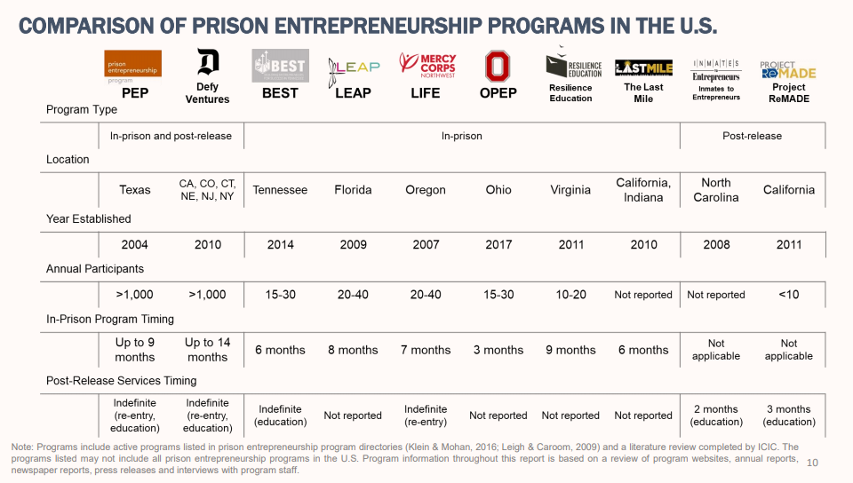
Source: https://www.pep.org/wp-content/uploads/2018/07/ICIC_PEP-Impact-Analysis_final_post.pdf

Slide 5
Entrepreneurial Reentry Program¹
Two locations: Dillwyn (men’s) and Fluvanna (women’s) correctional facilities, Virginia
Four Entrepreneurial Educational Programs:
Entrepreneurship
Foundations in Business
Financial Capability
Achieving Success in Personal Finance
Objectives:
Deliver high-quality educational programming for underserved populations
Promote financial stability
Reduce recidivism
Expand perspectives of MBA volunteers
¹ Resilience Education Executive Summary: https://static1.squarespace.com/static/5bc4fff016b6405451831f02/t/5ccc4ad97b81f800016ae8ef/1556892387541/R1+_+UPDATED+2+_+RE+Executive+Summary+%28February+2018%2C+Board%29+%282%29.pdf

Slide 6
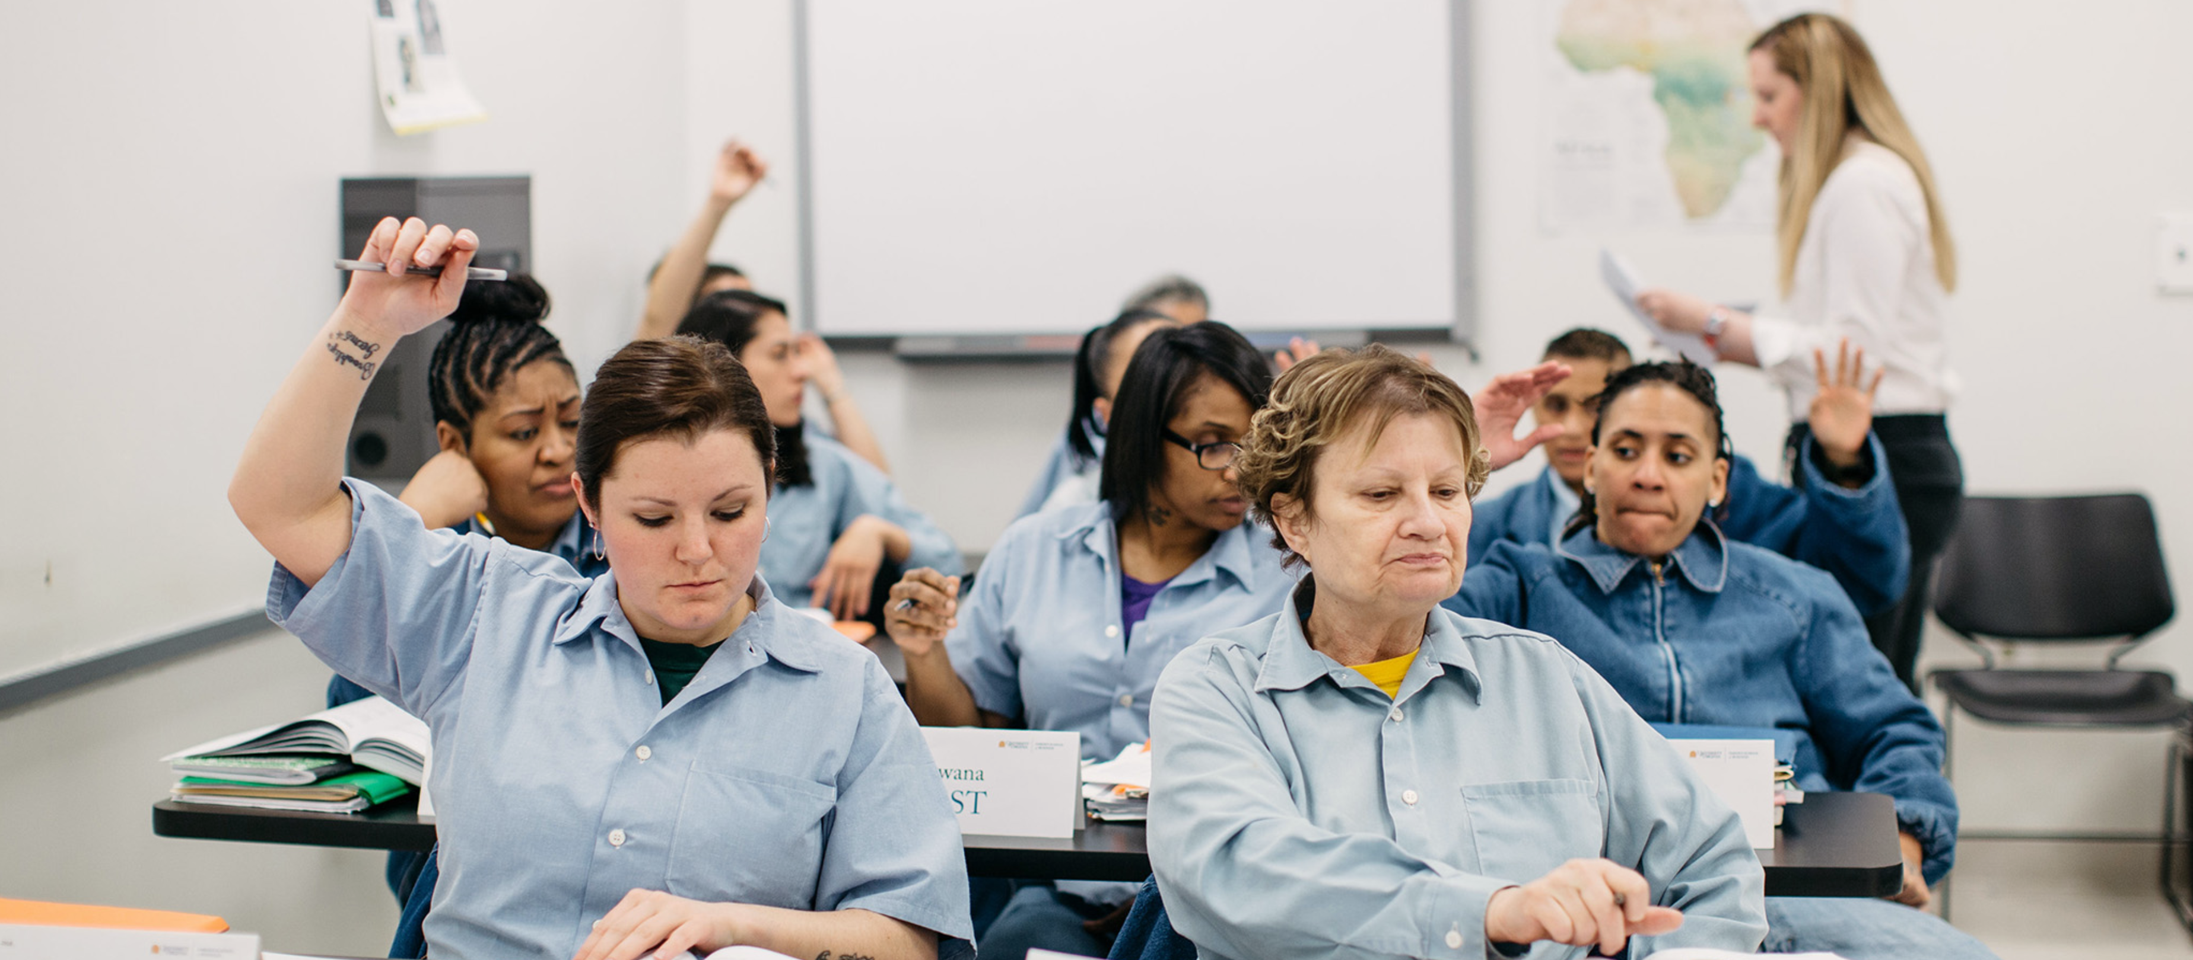
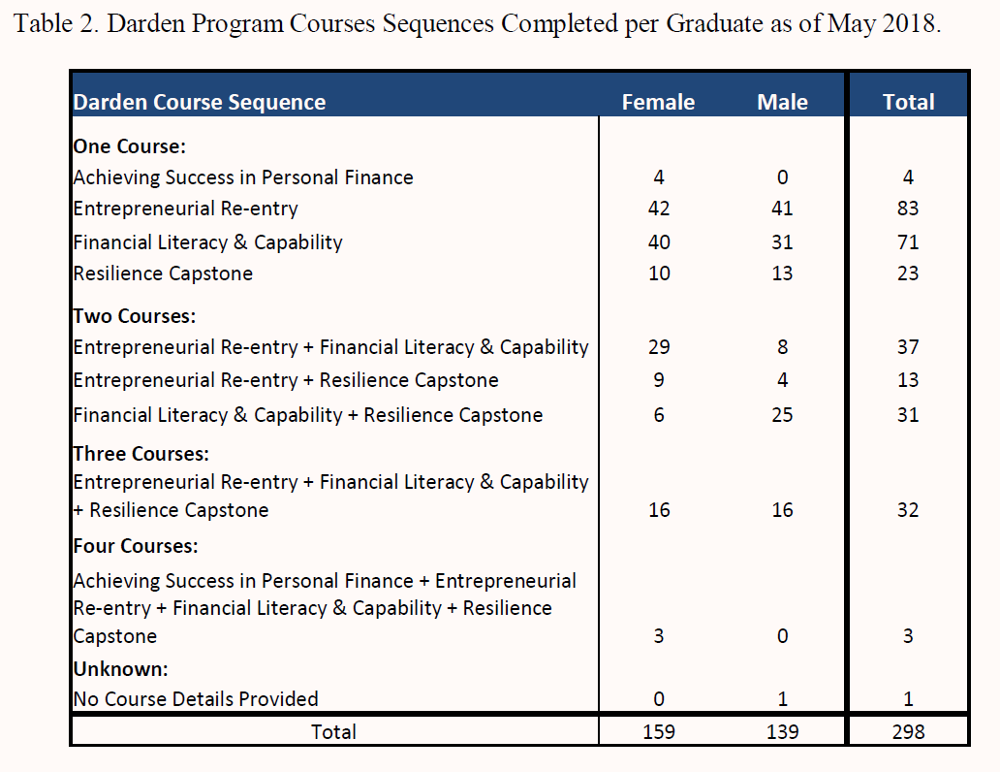
Participant Characteristics
Have a high school diploma or GED prior to entering the program
Be at least two years without an infraction or charge while incarcerated
Complete a math test
Priority is given to individuals who have 36 months or less until their release into the community
Sex offenders are generally excluded
As of May 2018, 298 individuals (159 female, 139 male) have completed at least one of the four courses; only 3 have completed all of the courses
Source: Virginia Department of Corrections, Resilience Education Programming: Preliminary Evaluation Summary. January 2019.

Slide 7
Literature Review
Prison re-entry has an adverse effect on returning prisoners and their communities, as well as significant financial costs
Benefits of prison educational programs:
Educational programs at all levels lower recidivism in most studies
Educational programs had positive effect on post-release earnings and employment*
College-level classes effective at lowering odds of inmates engaging in misconduct (other levels not studied)
Recidivism is an imperfect measure
Only accounts for reported crime
Not measured consistently
Considers returning offenders equally (even when inappropriate)
*when participants are compared against like groups

Slide 8
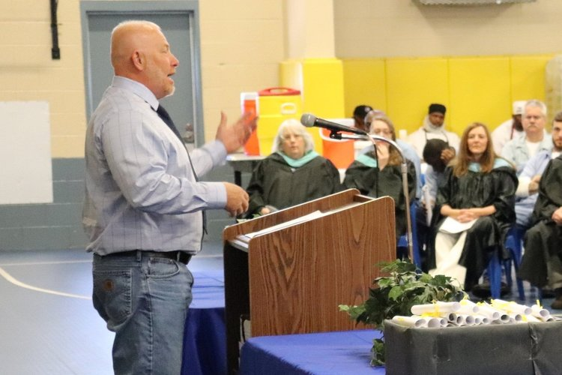
Information requests
From Resilience Education, we have received:
Video of Socratic Method in action
Course syllabi and descriptions
Math pre-test and final exam
Math practice tests
Sample business plan
Interview protocol
Sample case, sample teaching notes
From Virginia Department of Corrections we are hoping to receive:
number of infractions before and after course completion
release plans

Slide 9

Next Steps
Set up meeting with Virginia Department of Corrections
Get added to Darden IRB for this program
Get in touch with the Prison Entrepreneurship Program and ask for copy of their graduate survey as a guideline for creating our own survey for future administration by Resilience Education
Determine what kind of data collection and analysis is possible

Slide 10
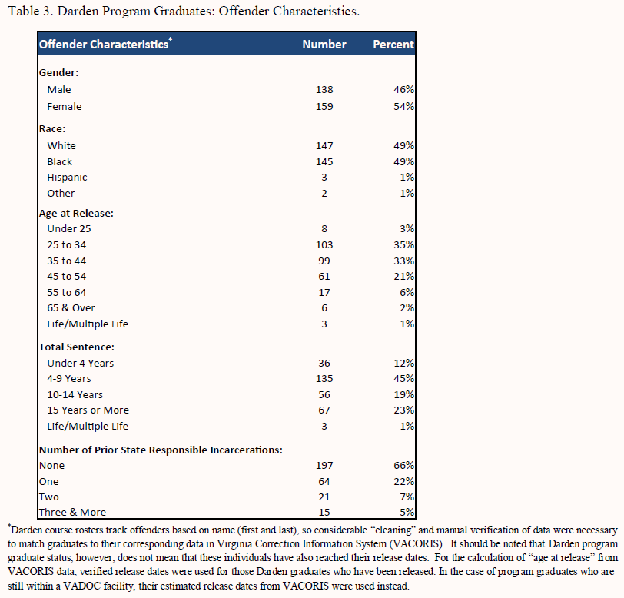
Appendix
Source: Virginia Department of Corrections, Resilience Education Programming: Preliminary Evaluation Summary. January 2019.

